Slide 1

Pricing of Flights
TEAM: JORDINA ORCAJO, ANGELA ROCA, ALBA CONDE, ROGER BORRÀS
TUTOR: SANTI SEGUÍ

Slide 2

INDEX
1. Summary
2. DataSet
3. Descriptive Analysis
4. Pricing Modelization
5. Simulation
6. WebScrapping
7. Conclusions
8. Further Steps
9. Resources

Slide 3
SUMMARY

Slide 4
SUMMARY
DATASET
DESCRIPTIVE ANALYSIS
PRICING MODELIZATION
SIMULATION
WEB
SCARPPING
CONCLUSIONS
FURTHER STEPS
RESOURCES
  Model pricing fluctuations.
  Pricing differences between operators.
  Defining purchasing strategies.
  Training a ticket pricing prediction model.
  Training a classification model to recommend users to purchase the ticket or not.
Notes:
De manera periòdica (heterogènia) es registren els preus de vols futurs, fins el mateix dia de sortida.

Slide 5
DATASET

Slide 6



SUMMARY
DATASET
DESCRIPTIVE ANALYSIS
PRICING MODELIZATION
SIMULATION
WEB
SCARPPING
CONCLUSIONS
FURTHER STEPS
RESOURCES
November , 2015 - May, 2016
73.756
2.254
Features :
  ID_Ticket
  Origin City
  Destination City
  Airline Company
  Departure Day
  Departure WeekDay
  Departure Time
  Arrival Day
  Arrival WeekDay
  Arrival Time
  Flight Duration
  Pricing
  Type of Demand*
  Days In Advance
  Query Day
  Query WeekDay
Notes:
De manera periòdica (heterogènia) es registren els preus de vols futurs, fins el mateix dia de sortida.

Slide 7
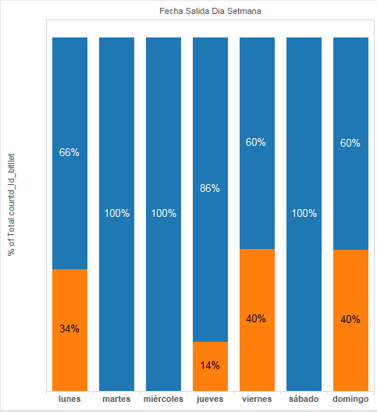
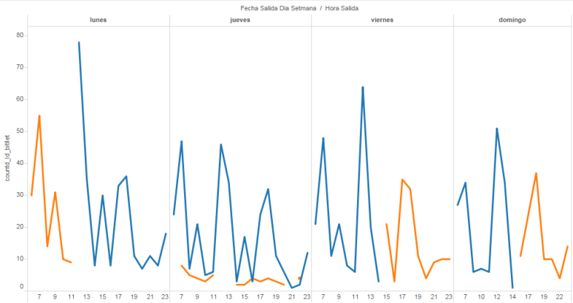
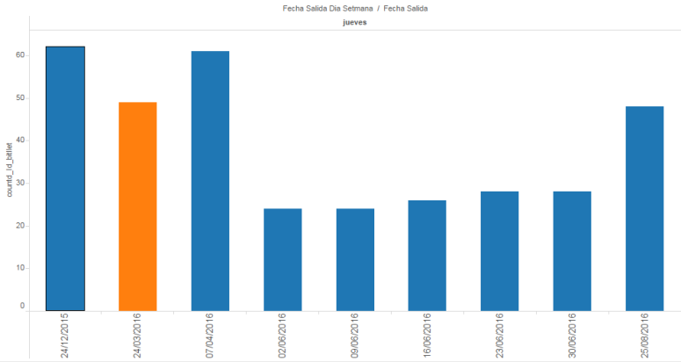
Type of demand
SUMMARY
DATASET
DESCRIPTIVE ANALYSIS
PRICING MODELIZATION
SIMULATION
WEB
SCARPPING
CONCLUSIONS
FURTHER STEPS
RESOURCES
  The high demand days are Monday, Thursday, Friday and Sunday.
  The high demand time slots are on Monday morning, Friday afternoon and Sunday afternoon.
  High demand flights are also defined by bank holidays (Easter).
Notes:
De manera periòdica (heterogènia) es registren els preus de vols futurs, fins el mateix dia de sortida.

Slide 8
DESCRIPTIVE
ANALYSIS

Slide 9
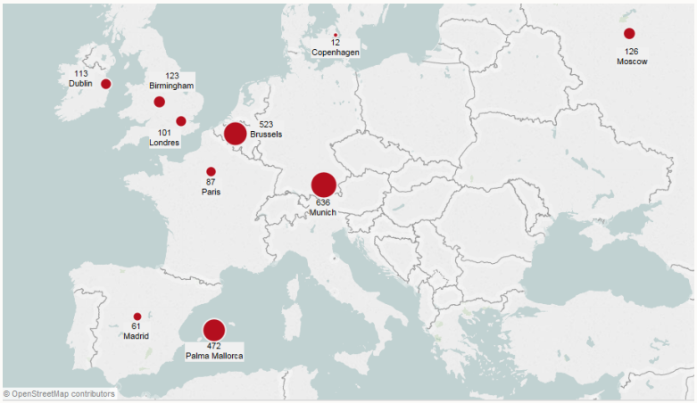
SUMMARY
DATASET
DESCRIPTIVE ANALYSIS
PRICING MODELIZATION
SIMULATION
WEB
SCARPPING
CONCLUSIONS
FURTHER STEPS
RESOURCES
Fig.1 : Destination Map

Slide 10
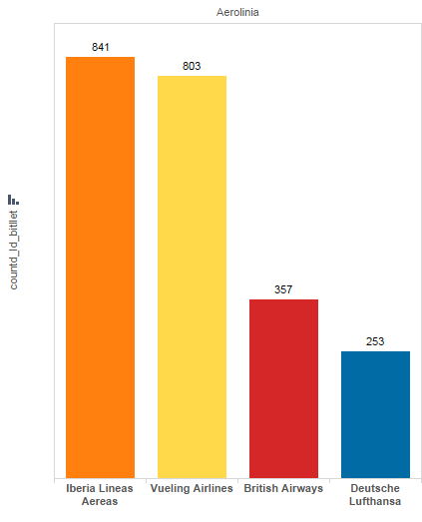
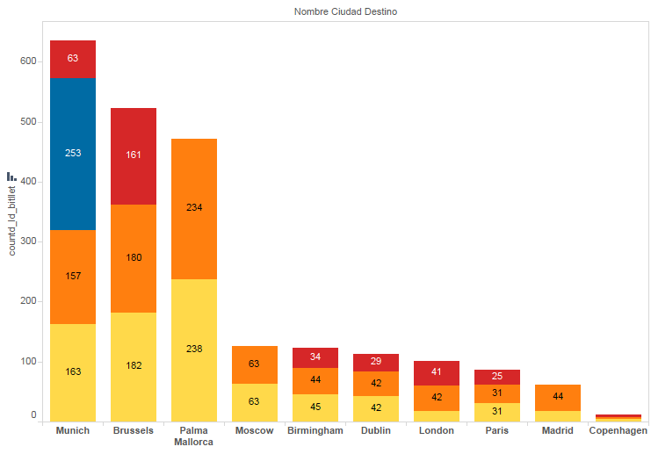
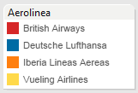
SUMMARY
DATASET
DESCRIPTIVE ANALYSIS
PRICING MODELIZATION
SIMULATION
WEB
SCARPPING
CONCLUSIONS
FURTHER STEPS
RESOURCES
Fig.2 : Tickets by operator
Fig.3 : Destination by operator
Notes:
Les destinacions de Lufthansa s’ajusten només a Munich i les companyies Iberia i Vueling son les que tenen un volum de vols més gran.

Slide 11
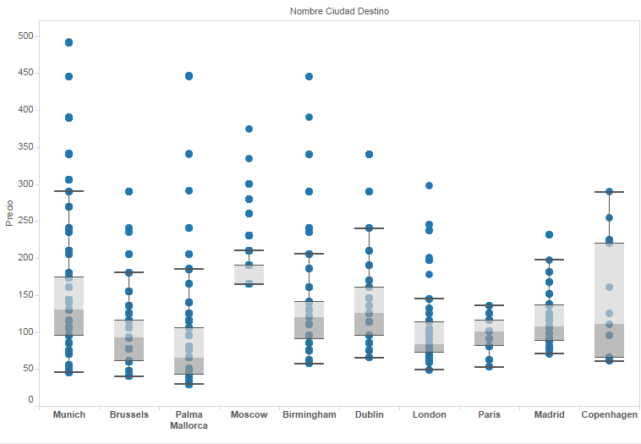
SUMMARY
DATASET
DESCRIPTIVE ANALYSIS
PRICING MODELIZATION
SIMULATION
WEB
SCARPPING
CONCLUSIONS
FURTHER STEPS
RESOURCES
Fig.4 : Pricing distribution by destination
Notes:
La variabilitat de preus és per destí. Copenhagen té molta variabilitat però és més normal donat que només tenim 12 vols.

Slide 12
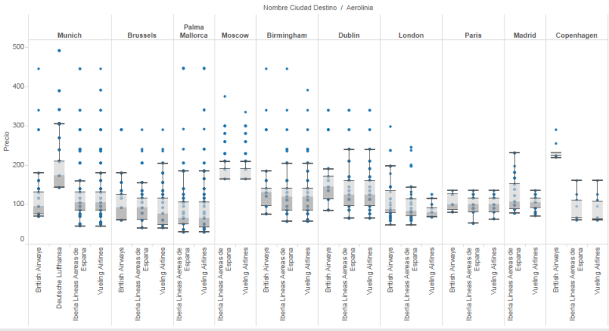
SUMMARY
DATASET
DESCRIPTIVE ANALYSIS
PRICING MODELIZATION
SIMULATION
WEB
SCARPPING
CONCLUSIONS
FURTHER STEPS
RESOURCES
Fig.5 : Pricing distribution by destination and by operator
Notes:
* Podem veure que els preus de Munich es veuent alterats pel preu de Lufthansa davant de les altres companyies.

Slide 13
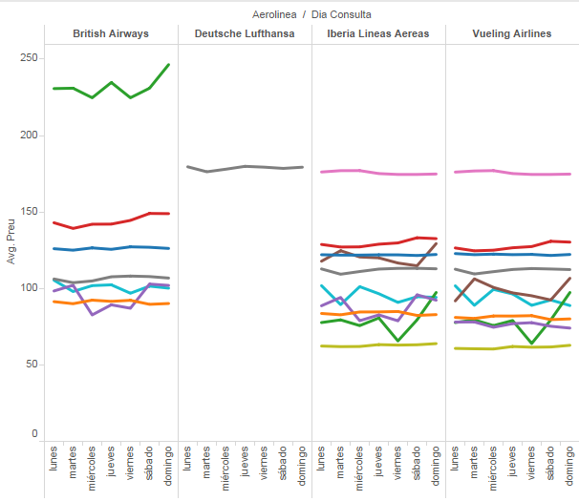
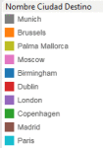
SUMMARY
DATASET
DESCRIPTIVE ANALYSIS
PRICING MODELIZATION
SIMULATION
WEB
SCARPPING
CONCLUSIONS
FURTHER STEPS
RESOURCES
Fig.6 : Average pricing distribution by weekday destination and operator
Notes:
.

Slide 14
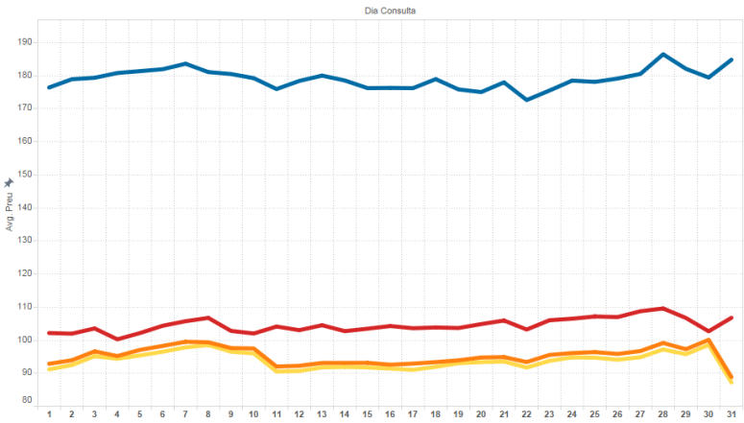
SUMMARY
DATASET
DESCRIPTIVE ANALYSIS
PRICING MODELIZATION
SIMULATION
WEB
SCARPPING
CONCLUSIONS
FURTHER STEPS
RESOURCES
Fig.7 : Average pricing distribution by Buy Date and operator
Notes:
Destacar que Iberia i Vueling té una tendència molt semblant.

Slide 15
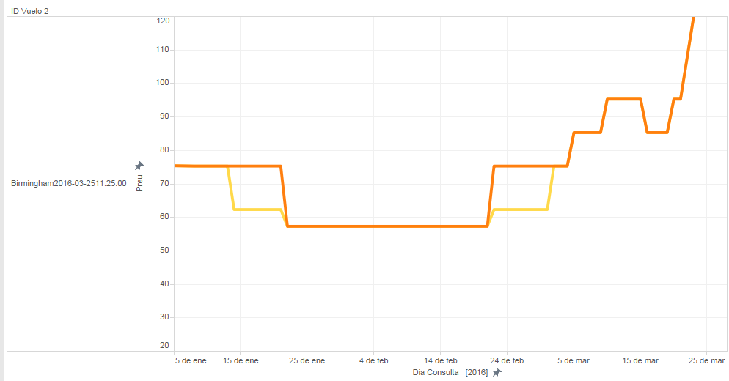
SUMMARY
DATASET
DESCRIPTIVE ANALYSIS
PRICING MODELIZATION
SIMULATION
WEB
SCARPPING
CONCLUSIONS
FURTHER STEPS
RESOURCES
Fig.8 : Pricing evolution by Buy Date and operator of an specific flight
Notes:
Per les gràfiques anteriors podem intuir que comparteixen avions. Agrupant per destí i hora, sense diferenciar per companyia, hem vist que hi han dues que operen amb alguns vols iguals.

Slide 16
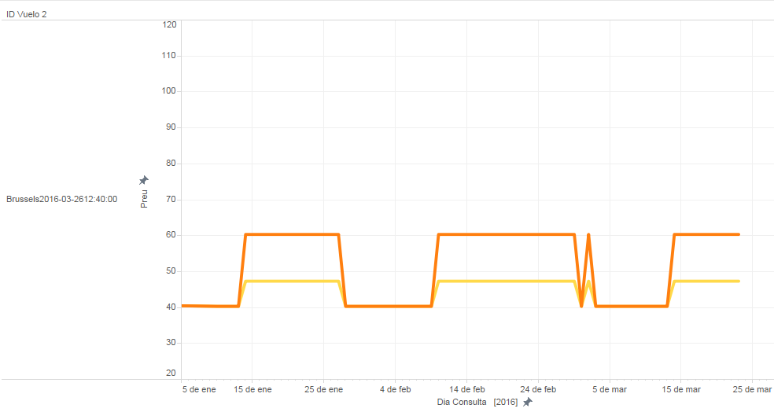
SUMMARY
DATASET
DESCRIPTIVE ANALYSIS
PRICING MODELIZATION
SIMULATION
WEB
SCARPPING
CONCLUSIONS
FURTHER STEPS
RESOURCES
Fig.9 : Pricing evolution by Buy Date and operator of an specific flight
Notes:
Per les gràfiques anteriors podem intuir que comparteixen avions. Agrupant per destí i hora, sense diferenciar per companyia, hem vist que hi han dues que operen amb alguns vols iguals.

Slide 17
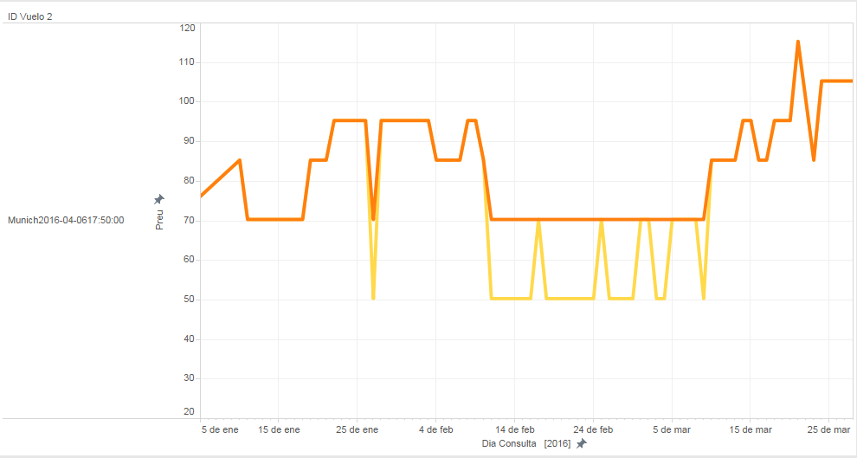
SUMMARY
DATASET
DESCRIPTIVE ANALYSIS
PRICING MODELIZATION
SIMULATION
WEB
SCARPPING
CONCLUSIONS
FURTHER STEPS
RESOURCES
Fig.10 : Pricing evolution by Buy Date and operator of an specific flight
Notes:
Per les gràfiques anteriors podem intuir que comparteixen avions. Agrupant per destí i hora, sense diferenciar per companyia, hem vist que hi han dues que operen amb alguns vols iguals.

Slide 18
PRICING
MODELIZATION

Slide 19
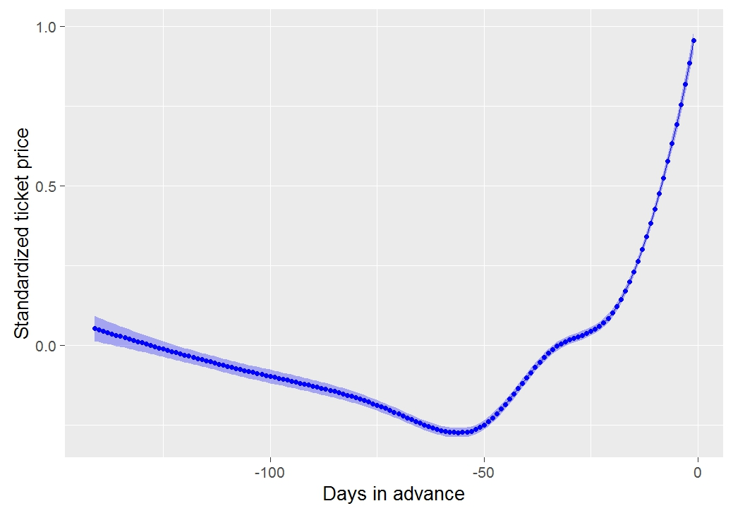
SUMMARY
DATASET
DESCRIPTIVE ANALYSIS
PRICING MODELIZATION
SIMULATION
WEB
SCARPPING
CONCLUSIONS
FURTHER STEPS
RESOURCES
Model Pricing Fluctuations
  The cheapest price is on the 55th day before the departure time (8 weeks left).
0.18 €
0.42 €
0.03 €
Fig.11 : Local regression of global pricing fluctuation

Slide 20
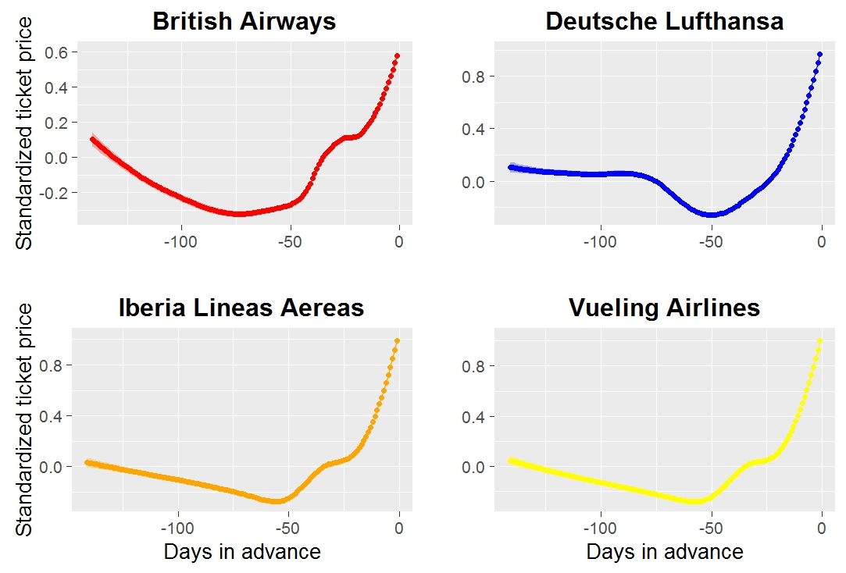
SUMMARY
DATASET
DESCRIPTIVE ANALYSIS
PRICING MODELIZATION
SIMULATION
WEB
SCARPPING
CONCLUSIONS
FURTHER STEPS
RESOURCES
Pricing between operators
Fig.12 : Local regression of global pricing fluctuation by operator

Slide 21
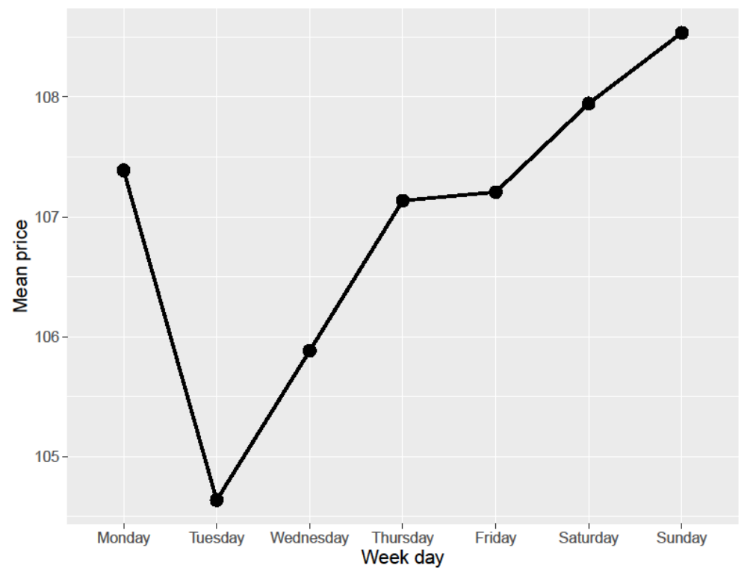
SUMMARY
DATASET
DESCRIPTIVE ANALYSIS
PRICING MODELIZATION
SIMULATION
WEB
SCARPPING
CONCLUSIONS
FURTHER STEPS
RESOURCES

Slide 22
SUMMARY
DATASET
DESCRIPTIVE ANALYSIS
PRICING MODELIZATION
SIMULATION
WEB
SCARPPING
CONCLUSIONS
FURTHER STEPS
RESOURCES
Purchaising strategies
  The cheapest day to fly is Wednesday (90 € on average). On Sunday is the most expensive and worth 40 €.
  To buy tickets, the best day is Tuesday. And the worst is Sunday worth 4 €.
  The days of high demand the prices are 18 € higher.

Slide 23
SUMMARY
DATASET
DESCRIPTIVE ANALYSIS
PRICING MODELIZATION
SIMULATION
WEB
SCARPPING
CONCLUSIONS
FURTHER STEPS
RESOURCES
Training a Ticket Pricing Prediction Model
We train a model to predict the price, with the:
  day of departure
  day of purchase
  the days ahead
  we obtained an R2 of 0.57.
  the demand type (high/low)
  the company
  the city of destination

Slide 24





Recommender
SUMMARY
DATASET
DESCRIPTIVE ANALYSIS
PRICING MODELIZATION
SIMULATION
WEB
SCARPPING
CONCLUSIONS
FURTHER STEPS
RESOURCES
  Our recommender will suggest to buy or not to buy.
  We create an output variable which tell us if the price will decrease or increase in the future.
  We apply different methods with 10-fold cross-validation.
  Logistic regression
  Cart

Slide 25
SIMULATION

Slide 26
SUMMARY
DATASET
DESCRIPTIVE ANALYSIS
PRICING MODELIZATION
SIMULATION
WEB
SCARPPING
CONCLUSIONS
FURTHER STEPS
RESOURCES
  Un vol que surt el dia 15 divendres, 7.10 AM – MUNICH
    Dia de la query : 10/07 (PREU = 75e)
    fecha_salida_dia_setmana = viernes
    dia_query_dia_setmana = diumenge
    dias_antelacion= 5
    nombre_ciudad_destino =Munich
    Aerolinia= Vueling
    Duracion= 2h 05 min
    Demanda= No
  Volem la diferencia entre el preu esperat/real. I veure com funciona el recomandar?

Slide 27
WEB-SCRAPPING

Slide 28
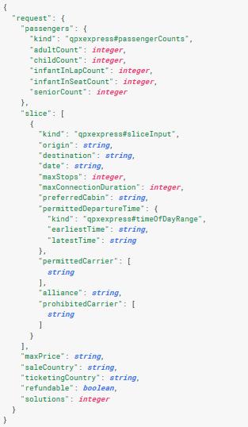
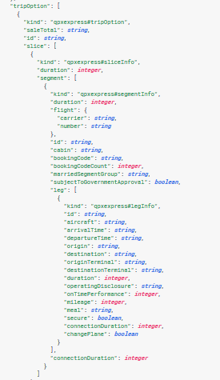
SUMMARY
DATASET
DESCRIPTIVE ANALYSIS
PRICING MODELIZATION
SIMULATION
WEB
SCARPPING
CONCLUSIONS
FURTHER STEPS
RESOURCES
API Google Flights (https://www.google.es/flights/)
RESPONSE
REQUEST

Slide 29
SUMMARY
DATASET
DESCRIPTIVE ANALYSIS
PRICING MODELIZATION
SIMULATION
WEB
SCARPPING
CONCLUSIONS
FURTHER STEPS
RESOURCES
Automatic program to scrap data from Google Flights.
Aim : Recollect new data for future steps.

Slide 30
CONCLUSIONS

Slide 31
SUMMARY
DATASET
DESCRIPTIVE ANALYSIS
PRICING MODELIZATION
SIMULATION
WEB
SCARPPING
CONCLUSIONS
FURTHER STEPS
RESOURCES
  Iberia and Vueling have a very similar pack of flights.
  Their prices are often different.
  Travelling to Munich with Lufthansa is the most expensive price.
  Destí/Compañia més variable
  The price to buy depends more of the weekday than the part of the month.
  The cheapest day to buy tickets is Tuesday, 4 € less than Sunday which is the most expensive.
  The best period to buy a ticket is 8 week before the departure day. (intentar conseguir un porcentaje)

Slide 32
FURTHER STEPS

Slide 33
SUMMARY
DATASET
DESCRIPTIVE ANALYSIS
PRICING MODELIZATION
SIMULATION
WEB
SCARPPING
CONCLUSIONS
FURTHER STEPS
RESOURCES
  Validation of the recommender with new datasets.
  Models improvement including more training data.
  Historic data to find patterns (seasonality, etc)
  Finding the reasons why the strategy of Vueling is cheaper than the Iberia one.

Slide 34
RESOURCES

Slide 35





SUMMARY
DATASET
DESCRIPTIVE ANALYSIS
PRICING MODELIZATION
SIMULATION
WEB
SCARPPING
CONCLUSIONS
FURTHER STEPS
RESOURCES
  Link del GITHUB
  Link del BLOC
  Tools:
    R Studio : Per al tractament de dades.
    Sypder :
    Wordpress :
    Tableau :
  Ordenar los tools y explicar en qué se han usado por encima.

